Slide 1
M Tech(Data Science & Engineering) Introduction to Statistical Methods

Slide 2
Session No 4
Testing of Hypothesis

Slide 3
Agenda
1
Need for testing of hypothesis, Definition hypothesis, null and alternative hypothesis, One-tailed and Two-tailed hypothesis,Type-I and Type-II errors, α-errors, β-errors, confidence level, power of the test and P-value
2
Definition of Statistical test, Difference between large sample and small sample tests, Different types of test
3
Understand and apply different parametric tests like Z-test,
Student’s t-tests, F-test, ANOVA.
4
Understand and apply different non-parametric tests like Chi-square tests, Fisher’s exact probabilities,

Slide 4
Random Variable
Need for testing of hypothesis
Often the decisions are made based on samples estimates to generalize on population parameter (as described in sampling and estimation).
In this process, there may be a difference between the estimate and the parameter which needs to be examined.

Slide 5

Need for testing of hypothesis
The following possibilities might arise due to sampling
Case(i): If the difference is zero, it is called
unbiased

Slide 6
Need for testing of hypothesis
Case(ii): If the difference is small, it may due to chance or sampling error (improper sampling technique used leads to sampling error)
Case(iii): If the difference is large, it may a real one or due to sampling error (improper sampling technique used leads to sampling error)
Hence, there is a need to test what type of difference is between estimate and parameter.

Slide 7
Hypothesis
A statement which is yet to be proved/ established or a statement on the parameter(s) of the Probability distribution to be tested
Null Hypothesis
Alternative Hypothesis
Hypothesis of no difference or neutral or may be due to Sampling variation
Hypothesis of difference which is yet to be proved/ established

Slide 8


Hypothesis
Hypothesis testing (Non-statistical)
A suspected criminal is produced before jury. The Jury has to decide whether the defendant is innocent or guilty.
Criminal Trial
Jury must decide between two hypotheses
Jury
H₀: The defendant may be innocent
The null hypothesis
The alternative hypothesis
H₁: The defendant may be guilty

Slide 9
Hypothesis
The jury do not know which hypothesis is true. The jury should make a decision on the basis of evidence presented before them by the advocates .

Slide 10
Hypothesis - Formulation
A taxi company manager is trying to decide whether the use of radial tires or regular belted tires improves fuel economy.
The variable measured is quantitative, therefore

Slide 11


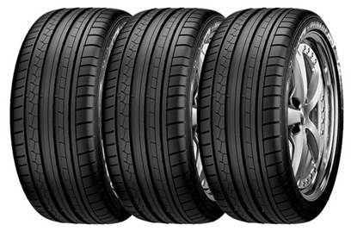

Hypothesis - Formulation
Manager
Regular Tyres
Radial Tyres
The variable measured fuel consumption
Quantitative

Slide 12
Hypothesis - Formulation
The mean fuel consumption in cars fitted with radial tyres and regular belted tires will be same
Note: H₀ can also be stated as one-tailed
The mean fuel consumption in cars fitted with radial tyres may be inferior to regular belted tires

Slide 13
Hypothesis - Formulation
The mean fuel consumption in cars fitted with radial tires may be better than regular belted tires
The mean fuel consumption in cars fitted with radial tires and regular belted tires may be different

Slide 14
Hypothesis - Formulation
Two judges have to judge independently whether the defendant is innocent or guilty on the basis of evidence. Lack of sufficient evidence may lead to erroneous decisions like false positive or false negative. Suppose based on evidences, if we are interested in finding proportion of false positivity in the judgement, then the hypothesis to be tested, if variable measured is qualitative will be

Slide 15

Hypothesis - Formulation
Judge 1
Judge 2
Suppose based on evidences, if we are interested in finding proportion of false positivity in the judgment of two Judges
Formulate the hypotheses
???

Slide 16
Hypothesis - Formulation
The proportion of false positive judgement between Judges may be same
The proportion of false positive judgement by Judge 1 may be lower than proportion of false positive judgement by Judge 2

Slide 17
Hypothesis - Formulation
The proportion of false positive judgement by Judge 1 may be more than proportion of false positive judgement by Judge 2
The proportion of false positive judgement between both Judges may be different

Slide 18
Test

Slide 19

Test
Test is a statistical rule which decides whether to accept the null hypothesis or not ?
Warning
Decision is made based on the sample not on the population
Leads to possibility of error between the decision
made and the reality

Slide 20
Types of test
A statistical rule which decides whether to accept or reject the null hypothesis on the basis of data
Parametric tests
Non-parametric tests
Based on the assumption of some probability distribution
Not based on any assumption of probability distribution

Slide 21
Parametric tests
Large Sample Test
n ≥ 30
It is assumed that the data do follow some probability distribution which is
characterized by any parameters.
Standard Normal Test
Z-Test
Small Sample Test
n < 30
Unpaired t-Test
Student’s t-test
Paired t-Test
ANOVA
Analysis of Variance
Rm ANOVA

Slide 22
Non - Parametric tests
It is assumed that the data do not follow any probability distribution which is not characterized by any parameters.
Distribution - free tests
Chi - Square Test
Fisher’s exact probabilities
Mann – Whitney U test
Wilcoxon Signed Rank Test
Kruskal - WallisTest
Friedman’sTest

Slide 23
Steps involved in Testing of Hypothesis
State null and alternative hypotheses
Specify the level of significance ‘α’
Define the probability distribution the data follows
Compute the test statistic based defined population
Define the rejection criteria/critical regional
Conclusion

Slide 24
Computation of test-statistic: Example
Based on the sample data the test-statistic should be computed using
Based on the computed value of test-statistic the H₀ will either be accepted or rejected

Slide 25
Errors in decision making
Any example based on data
Any example based on data
Statistical Example
Statistical Example
Null Hypothesis (H₀)
Null Hypothesis (H₀)
Decision
Decision
True
False
True
False
Type – II
Error
Accept
Accept
Reject
Reject
Type – I
Error

Slide 26
Errors in decision making
Any example based on data
Any example based on data
Statistical Example
Statistical Example
Null Hypothesis (H₀)
Null Hypothesis (H₀)
Decision
Decision
True
False
True
False
Confidence
Level (1-α)
Accept
β - error
Accept
Power
(1-β)
Reject
α- Error
Reject

Slide 27
Decision on α –error and β - error
Conventionally
Fix α at 5%
Minimize β
Maximize 1-β

Slide 28

Parametric tests
This is a test based on Standard Normal Distribution
Z-test
Used for testing the
Mean of a single population (µ)
Difference between means of two populations (µ₁ - µ₂)
Proportion of a single population (P)
Difference between proportions of two populations (P₁ - P₂)

Slide 29
Assumptions on Z-test
Samples are drawn from normal distribution
The population variances should be known
Z-test
Two groups should be independent
Subjects should be allocated randomly to both groups
The sample size should be more than 30 (i.e., n ≥ 30)

Slide 30
Testing mean of a single population
1
State null and alternative hypothesis
2
Specify the level of significance ‘α’
3
Standard Normal Distribution
4
Compute the test statistic
5
Define the critical region/ rejection criteria
6
Conclusion

Slide 31
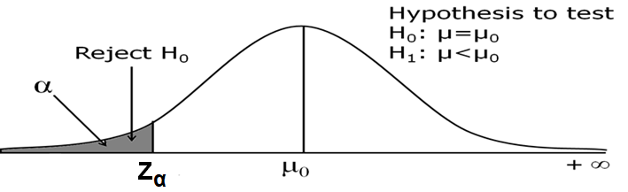
Rejection criteria
5
Define the critical region/ rejection criteria
(i)
Reject H₀ if computed value of Z is less than the critical value, ie., P(Z < -z_{α}), otherwise do not reject H₀
6
Conclusion

Slide 32
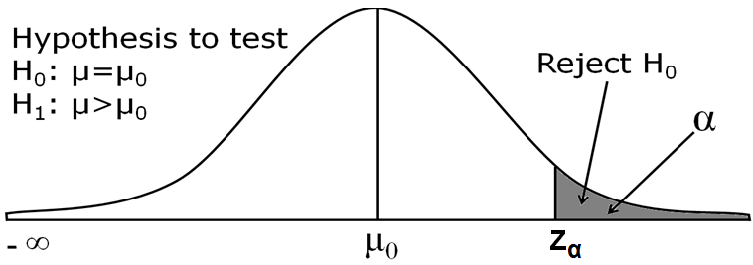
Rejection criteria
5
Define the critical region/ rejection criteria
(ii)
Reject H₀ if computed value of Z is greater than the critical value, ie., P(Z > z_{α}), otherwise do not reject H₀
6
Conclusion

Slide 33
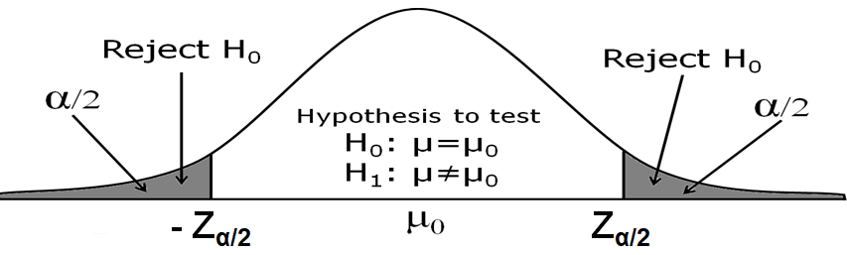
Rejection criteria
5
Define the critical region/ rejection criteria
(iii)
Reject H₀ if computed value of Z is less than or greater than the critical value, ie., P(Z < - z_{α/2}) or P(Z > z_{α/2}), otherwise do not reject H₀
6
Conclusion

Slide 34
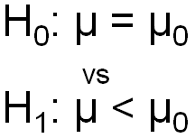
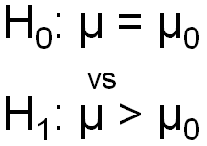
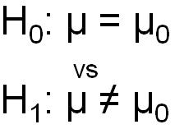
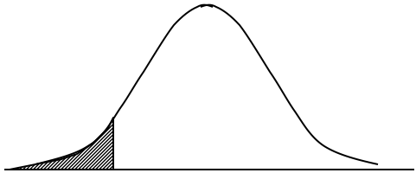
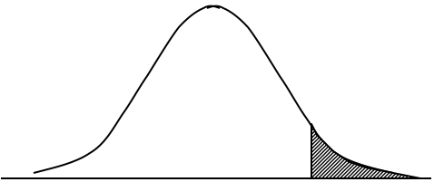
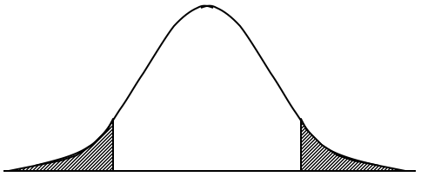
Rejection criteria
Summary of One- and Two-Tail Tests
One-Tail Test (left tail) | One-Tail Test (right tail) | Two-Tail Test (Either left or right tail)

Slide 35
Example
It is claimed that sports-car owners drive on the average 17000 kms per year. A consumer firm believes that the average milage is probably higher. To check, the consumer firm obtained information from randomly selected 40 sports-car owners that resulted in a sample mean of 17352 kms with a population standard deviation of 1348 kms. At what can be concluded about this claim at
(a) 5% level of significance (Critical value is 1.645)
(b) 1% level of significance (Critical value is 2.331)

Slide 36
Example
The average milage of sports-car as claimed and the sample average milage may be same
The average milage of sports-car as claimed may be higher than the sample average milage

Slide 37
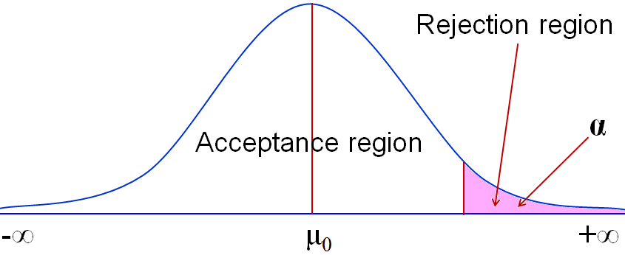
Example
(a) At 5% level of significance with critical value 1.645
Hypothesis to test
H₀:μ=17000
vs
H₁:μ>17000
Critical value for
α = 0.05 is 1.645
Since Z =1.650 > 1.645, Reject H₀ and Accept H₁
Z_{α}= 1.645
Z_{cal}= 1.650

Slide 38
Example
(b) At 1% level of significance with critical value 2.331
Hypothesis to test
H₀:μ=17000
vs
H₁:μ>17000
Critical value for
α = 0.01 is 2.331
Since Z =1.624 < 2.330, Accept H₀ Reject H₁
Z_{α}= 2.331
Z_{cal}= 1.650

Slide 39
Example
(a) At 5% level of significance with critical value 1.645
Critical value for α = 0.05 is 1.64 Since Z =1.650 > 1.64, Reject H₀. [17003.25, 17838.75]
Critical value for α = 0.05 is 2.33. Since Z =1.650 < 2.33, Accept H₀. [16871.11, 17970.89]
µ = 17000 included in

Slide 40

P-value
P - value
In hypothesis testing, the choice of the value of α is somewhat arbitrary. For the same data, if the test is based on two different values of α, the conclusion could be different. Many Statisticians prefer to compute the so called P-value, which is calculated based on the observed test statistic. For computing the P-value, it is not necessary to specify a value of α. We can use the given value data to obtain the P-value.

Slide 41
P-value
P – value: The strength of the evidence against the null
hypothesis that the true difference in the
population is zero
In other words
Corresponding to an observed value of a test statistic, the P-value (or attained level of significance) is the lowest level of significance at which the null hypothesis would have been rejected.

Slide 42



P-value
P - value
Possibility that the observed differences were a chance event
Entire population need to be studied to know that a difference is really present with certainty
Research community and statisticians had to pick a level of uncertainty at which they could live

Slide 43
P-value
If the P-value is less than 1% (< 0.01),
If the P-value is between 5% and 10%,
Overwhelming evidence that supports the alternative hypothesis
Weak evidence that supports the alternative hypothesis
If the P-value is between 1% and 5%,
If the P-value exceeds 10%,
Strong evidence that supports the alternative hypothesis
No evidence that supports the alternative hypothesis.

Slide 44
Z-test for difference between means
Z-test
Difference between means of two populations (µ₁ - µ₂)
Samples are drawn from normal distribution
The population variances should be known
Z-test
Two groups should be independent
Subjects should be allocated randomly to both groups
The sample size should be more than 30 (i.e., n ≥ 30)

Slide 45
Z-test for difference between means
1
State null and alternative hypothesis
2
Specify the level of significance ‘α’
3
Standard Normal Distribution
4
Compute the test statistic
5
Define the critical region/ rejection criteria
6
Conclusion
Note: Rejection criteria same as in one sample test or P-value

Slide 46
Example
The manager of a courier service believes that packets delivered at the beginning of the month are heavier than those delivered at the end of month. As an experiment, he weighed a random sample of 20 packets at the beginning of the month and found that the mean weight was 5.25 kg. A randomly selected 10 packets at the end of the month had a mean weight of 4.96 kg. It was observed from the past experience that the population variances are 1.20 kg and 1.15 kg. At 5% level of significance, can it be concluded that the packets delivered at the beginning of the month weigh more? Also find P-value and 95% confidence interval for the difference between the means.

Slide 47
Example
The mean weight of packets delivered at the early in the month and at the end of month may be same
The mean weight of packets delivered at the end of the month may be higher than at the early of month

Slide 48
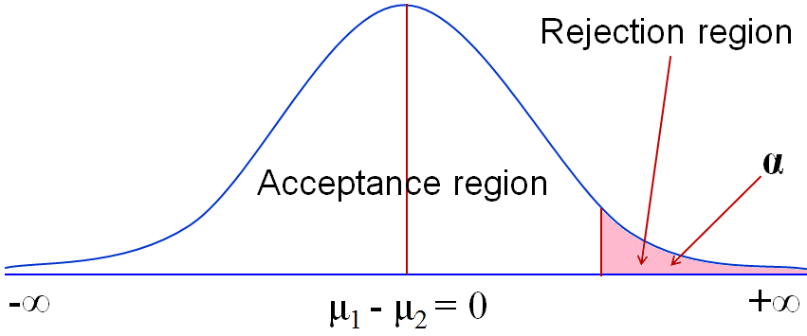
Example
At 5% (0.05) level of significance with critical value 1.645
Hypothesis to test
H₀:μ₁ - μ₂ = 0
vs
H₁:μ₁ – μ₂ > 0
???
95% CI for µ is
[- 454, 1.033]
Z_{cal}= 0.642
Z_{α}= 1.645
Critical value for α = 0.05 is 1.645. Since Z = 0.642 < 1.645, Accept H₀ Reject H₁

Slide 49
Z-test for proportion of a single population
Z-test
Proportion of a single population (P)
Assumptions
Assume that the samples are drawn from normal distribution
The sample size should be more than or equal to 30
Subjects should be selected randomly

Slide 50
Z-test for proportion of a single population
1
State null and alternative hypothesis
2
Specify the level of significance ‘α’
3
Standard Normal Distribution
4
Compute the test statistic
5
Define the critical region/ rejection criteria
6
Conclusion
Note: Rejection criteria same as in one sample test or P-value

Slide 51
Example
A builder claims that heat pumps are installed in 70% of all homes being constructed today in the city of Bangalore. Would you agree with this claim if a random sample of new homes in this city shows that 28 out of 55 had heat pumps installed? What P-value and confidence interval are related in this situation?

Slide 52
Z-test for difference between proportions
Z-test
Difference between proportion of two population (P₁-P₂)
Assumptions
Assume that the samples are drawn from normal distribution
The sample size should be more than or equal to 30
Subjects should be selected randomly
Two groups should be independent of each other

Slide 53
Z-test for difference between proportions
1
State null and alternative hypothesis
2
Specify the level of significance ‘α’
3
Standard Normal Distribution
4
Compute the test statistic
5
Define the critical region/ rejection criteria
6
Conclusion
Note: Rejection criteria same as in one sample test or P-value

Slide 54
Note
Based on sample size standard error for proportion may be calculated: If the sample sizes are equal then SE (P₁-P₂) is calculated by
Based on sample size standard error for proportion may be calculated: If the sample sizes are equal then SE (P₁-P₂) is calculated by

Slide 55

Example
Example on Z-test on difference in proportions
Use α = 1%.
Bangalore 2018
Kochi 2018
387/1500 BSNL telephones
connections were disconnected
310/1200 BSNL telephones
connections were disconnected
Is there a significant difference between the two proportion of telephones disconnection by BSNL?
Construct 99% confidence interval for difference in proportions

Slide 56
Student’s t-test
Independent sample
t-test
Unpaired
t-test
AND
Paired
t-test
OR
Independent Sample t-test
Testing mean of a single population
Testing difference between means of two populations

Slide 57
Mean of a single population using t-test
t-test
Testing mean of a single population (µ)
Assumptions
Assume that the samples are drawn from normal distribution
The population variance may be unknown
The sample size should be less than 30 (n < 30)
Subjects should be selected randomly

Slide 58
Mean of a single population using t-test
1
State null and alternative hypothesis
2
Specify the level of significance ‘α’
3
Student’s t-distribution
4
Compute the test statistic
5
Define the critical region/ rejection criteria
6
Conclusion
Note: Rejection criteria may be based on critical value or P-value

Slide 59
Mean of a single population using t-test
5
Define the critical region/ rejection criteria
(i)
Reject H₀ if computed value of t is less than the critical value, ie., P(t < - t_{α}), otherwise do not reject H₀
(ii)
Reject H₀ if computed value of t is greater than the critical value, ie., P(t > t_{α}), otherwise do not reject H₀
ᴥ
By combining both (i) and (ii), Reject H₀ if computed value of
ǀ t ǀ is greater than the critical value, ie., P(ǀ t ǀ > t_{α}), otherwise
do not reject H₀. Besides α, the df is also important.
6
Conclusion

Slide 60
Mean of a single population using t-test
5
Define the critical region/ rejection criteria
(iii)
Reject H₀ if computed value of t is less than or greater than the critical value, ie., P(t < - t_{α/2}) or P(t > t_{α/2}), otherwise do not reject H₀
ᴥ
Alternatively, reject H₀ if computed value of ǀ t ǀ is greater than the critical value, ie., P(ǀ t ǀ > t_{α/2}), otherwise do not reject H₀. Besides α, the degrees of freedom is also important.
6
Conclusion

Slide 61
Example
It is claimed that sports-car owners drive on the average 18580 kms per year. A consumer firm believes that the average milage is probably higher. To check, the consumer firm obtained information from randomly selected 10 sports-car owners that resulted in a sample mean of 17352 kms with a sample standard deviation of 2012 kms. What can be concluded about this claim at
(a) 5% level of significance
(b) 1% level of significance

Slide 62
Example
The average milage of sports-car as claimed and the sample average milage may be same
The average milage of sports-car as claimed may be higher than the sample average milage

Slide 63
Example
(a) At 5% level of significance with critical value 1.645
Hypothesis to test
H₀:μ=18580 vs H₁:μ>18580
Critical value for α = 0.05 is 1.833 for 9 degree of freedom
Since ǀ t ǀ =1.929 > 1.833, Reject H₀ and Accept H₁

Slide 64
Testing the difference between means
t-test
Difference between means of two populations (µ₁ - µ₂)
Samples are drawn from normal distribution
The population variances should be unknown
The sample size should be less than 30 (i.e., n < 30)
t-test
The population variances
should be equal
Two groups should be independent
Subjects should be allocated randomly to both groups
However even if sample size more than 30 (i.e., n > 30) and population variances unknown, t-test should be continue to apply, because of central limit theorem it approaches normal.

Slide 65
Testing the difference between means
1
State null and alternative hypothesis
2
Specify the level of significance ‘α’
3
Standard Normal Distribution
4
Compute the test statistic
5
Define the critical region/ rejection criteria
Note: If sample sizes are unequal compute pooled SE
6
Conclusion
Note: Rejection criteria may be based on critical value or P-value

Slide 66
Example
Random samples of 15 and 10 were selected from two thermocouples. The sample means were 315, 303 and sample standard deviations were 3.8, 4.9 respectively.
Construct 95% CI for difference in means
Test whether there is any significant difference in the means of two thermocouples at 5% level of significance
Find the P-value

Slide 67
Example
The mean of two thermocouples may be same
The mean of two thermocouples may be different

Slide 68
Example
At 5% (0.05) level of significance with critical value
Hypothesis to test
H₀:μ₁ - μ₂ = 0
vs
H₁:μ₁ – μ₂ > 0
95% CI for µ is
[6.24, 17.76] not includes 0
???
95% CI for µ is
[6.24, 17.76]
Critical value for α = 0.05 is 1.714. Since ǀ t ǀ = 3.571 > 1.714, Reject H₀ & Accept H₁

Slide 69
Student’s paired t-test
t-test
Testing mean before and after observations of a single population (µ_{d})
Assumptions
Assume that the difference between before and after observations follow normal distribution
The sample size should be less than 30 (n < 30)
Subjects should be selected randomly

Slide 70
Student’s paired t-test
1
State null and alternative hypothesis
2
Specify the level of significance ‘α’
3
Student’s t-distribution
4
Compute the test statistic
5
Define the critical region/ rejection criteria
But µ_{d} under H₀ will be 0
6
Conclusion
Note: Rejection criteria may be based on critical value or P-value

Slide 71
Student’s paired t-test
The HRD manager wishes to see if there has been any change in the ability of trainees after a specific training programme. The trainees take a aptitude test before and after training programme.
Subjects | Before (x) | After (y)
1 | 75 | 70
2 | 70 | 77
3 | 46 | 57
4 | 68 | 60
5 | 68 | 79
6 | 43 | 64
7 | 55 | 55
8 | 68 | 77
9 | 77 | 76

Slide 72
Example
Subjects | Before (x) | After (y) | d = y-x | (d-mean)²
1 | 75 | 70 | -5 | 100
2 | 70 | 77 | 7 | 4
3 | 46 | 57 | 11 | 36
4 | 68 | 60 | -8 | 169
5 | 68 | 79 | 11 | 36
6 | 43 | 64 | 21 | 256
7 | 55 | 55 | 0 | 25
8 | 68 | 77 | 9 | 16
9 | 77 | 76 | -1 | 36
Total |  |  | 45 | 678

Slide 73
Example
At 5% (0.05) level of significance with critical value is 3.31
Hypothesis to test
H₀:μ_{d} = 0
vs
H₁:μ_{d} > 0
95% CI for µ is
[[-2.52, 12.52] not includes 0
???
95% CI for µ is
[-2.52, 12.52]
Critical value for α = 0.05 is 1.895. Since ǀ t ǀ = 1.63 < 2.31, Accept H₀ & Reject H₁

Slide 74


Exercise
Diet-modification Program
Ten individuals have participated
Subject | 1 | 2 | 3 | 4 | 5 | 6 | 7 | 8 | 9 | 10
Weight Before | 195 | 213 | 247 | 201 | 187 | 210 | 215 | 246 | 294 | 310
Weight After | 187 | 195 | 221 | 190 | 175 | 197 | 199 | 221 | 278 | 285
Is there sufficient evidence to support claim that this program is effective in reducing weight?
Use α = 0.05.
Construct 95% confidence interval for mean difference.

Slide 75


Exercise
Test 1
Test 2
Is there sufficient evidence to conclude that both tests give the same mean impurity level
Specimen | 1 | 2 | 3 | 4 | 5 | 6 | 7 | 8
Test 1 | 1.2 | 1.3 | 1.5 | 1.4 | 1.7 | 1.8 | 1.4 | 1.3
Test 2 | 1.4 | 1.7 | 1.5 | 1.3 | 2.0 | 2.1 | 1.7 | 1.6
Using α = 0.01
Construct 99% confidence interval for mean difference

Slide 76
